Slide 1
Becoming an Outlier Career Reboot for the Developer Mind
Cory House bitnative.com | @housecor
Notes:
Tips for becoming a software virtuoso

Slide 2
Notes:
http://www.youtube.com/watch?v=je3rQevW-cw
Let’s start off with a confession: I’m going to talk a lot about passion, but I just spent nearly a year in a job I dreaded. Working to do things you don’t like so that you can continue doing things you don’t like is STUPID. – Alan Watts
This talk is not about getting rich. Though if you become an outlier you’ll have no trouble paying your bills. What’s money? A man is a success if he gets up in the morning and goes to bed at night and in between does what he wants to do. – Bob Dylan

Slide 3
Job, career, or calling?
Notes:
How many of you aspire to management? Keep your hands up if you think management is more enjoyable than development.
If it’s work, we try to do less. If it’s art, we try to do more. - Seth Godin
If your work is your art, you have a huge advantage.
If it’s not a calling, MOVE ON: Talking pays better than doing.
Why be an outlier? Self actualization
Architect > Construction manager > construction workers
Outlier != destination
http://www.fastcompany.com/39841/why-cant-we-get-anything-done

Slide 4
Lean in close…
The amount of success you have in life
is roughly equivalent to the amount of time you spend
doing things people want.
Notes:
Lean in close. I’m going to give you the cliff notes right up front. It's about consistently doing something people want. The amount of success you have is roughly equivalent to the amount of time you spend doing things people want. And doing that requires building the right habits.
Ever seen a job description:
wanted 5+ years experience watching Greys anatomy.
Familiarity with Royals starting lineup.
Cursory knowledge of house fires that occurred in the metro over the last week.

Slide 5
What’s an outlier look like?

Slide 6
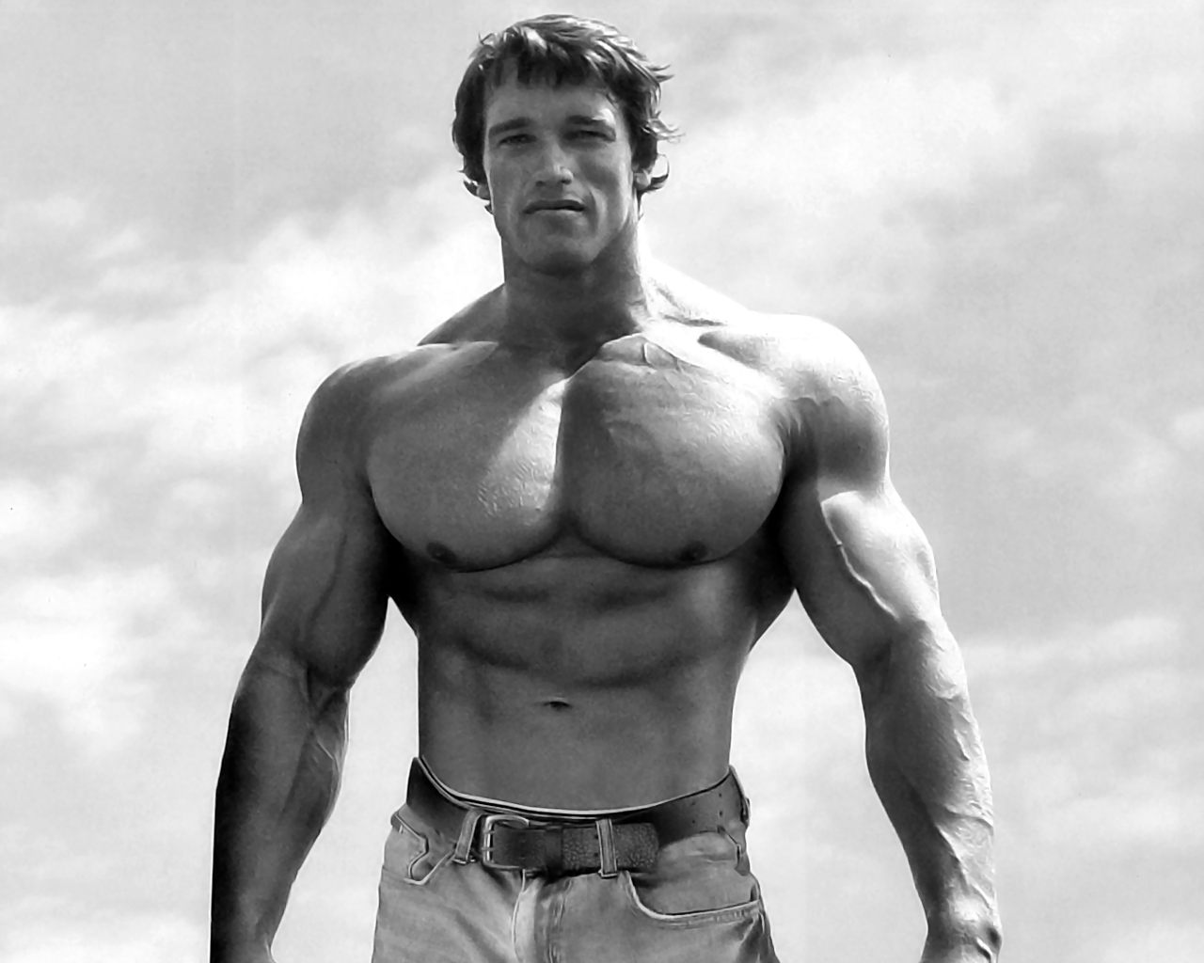
Notes:
1969 - 1975 Mr. Olympia. training six days per week; twice per day on Monday, Wednesday and Friday, and once per day on Tuesday, Thursday and Saturday.

Slide 8
2002
.NET 1.0
.NET 2.0
.NET 3.5
.NET 4.0
.NET 4.5
ASMX
WCF
Web API
Web Forms
Silverlight
MVC
Razor
ADO.NET
Linq-2-SQL
Entity Framework
EF Code First
Web API
2012
Notes:
We are on a technology treadmill. If you don't get a rush of endorphins from working out then you're highly unlikely to keep up. Related jobs quote about passion or you'll quit.
And by the way this is the risk when you become a department manager

Slide 9
Outlier…Worth it?
Impact
Self-actualization – it’s art.
Wealth - Work “with” rather than “for”
Notes:
Note what isn’t on this list?

Slide 10
Step 1: Command Your Time
Notes:
Be Modal, Command Time, Signal to Noise

Slide 11
You do something all day long, don’t you? The only difference is that you do a great many things and I do one.
Thomas Edison

Slide 12
Habits: 40%
TV
Hot Dog
Elevator
Consumption
Eating out
Soda
Doughnut
Buy new
Sleep in
Status Quo
Pessimism
The minimum
Book
Fish
Stairs
Creation
Sack lunch
Water
Apple
Buy used
Wake early
Growth
Optimism
Exceeding expectations
Source: The Power of Habit – Charles Duhigg

Slide 13
Teach Yourself Programming in 10 years – Peter Norvig

Slide 14
10k Hours for Expertise
Hours/day deliberate practice
Notes:
In studies of composers, basketball players, fiction writers, ice skaters, concert pianists, chess players.

Slide 15
How to Live on 24 Hours a Day
Your day is not full. You spend seven hours working, seven hours sleeping, and I'll give you another two hours. This leaves eight hours a day. You under-use these.
Arnold Bennett

Slide 16
Source: Main Event Management, Model-Netics
Notes:
Go to church with family
Ride bike to work
Go camping with church group and family
Building a house for habitat for humanity

Slide 17
Multithread Your Life

Slide 18
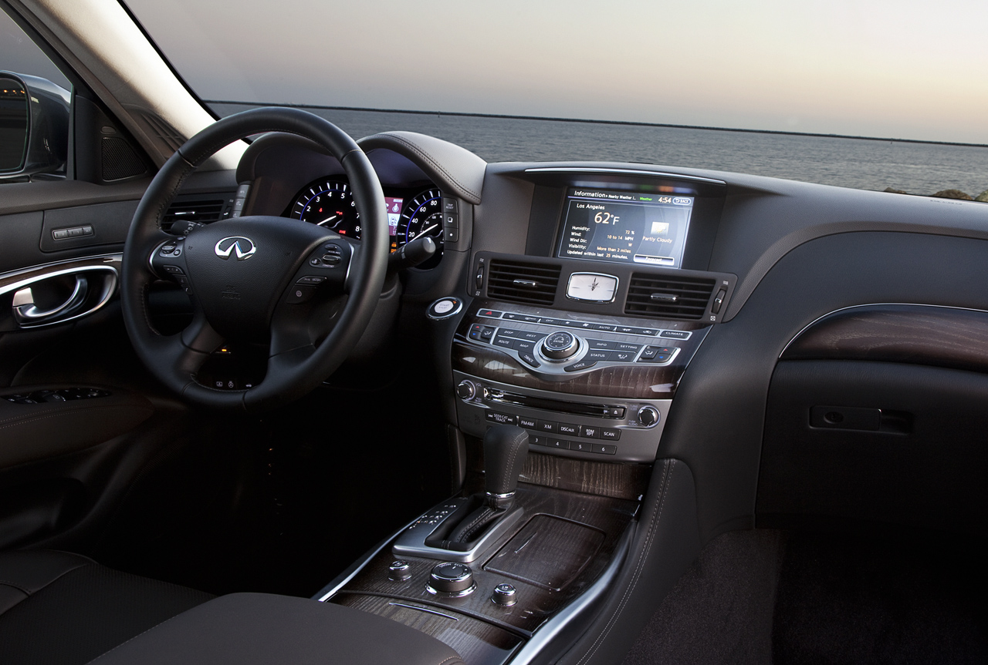
Hack The Commute
Notes:
Default: Sports Radio, Top 40, Political Talk
Outlier: Carpool /public transit / Remote, Work near home, Programming podcasts , Books on CD, Commute off peak
I save 20 mins roundtrip each day coming in at 7.
I save 40 mins/day twice a week WFH. That's 2.3 hrs/week. That's 3 extra weeks of time in a year!

Slide 19
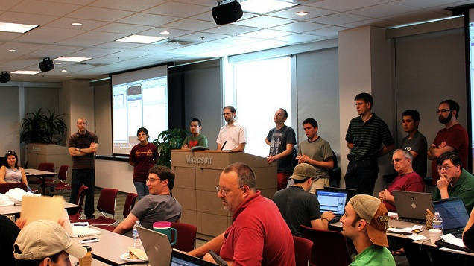
Rethink Giving Back
Default | Outlier
Build a house Coach little league Homeless shelter | Contribute to open source Pro bono development Give Camp
Donate your most valuable skill
Notes:
When you give using your greatest skill, you magnify the value of your gift by leveraging your most valuable talent. It's a win for all because you can improve at your craft.

Slide 20
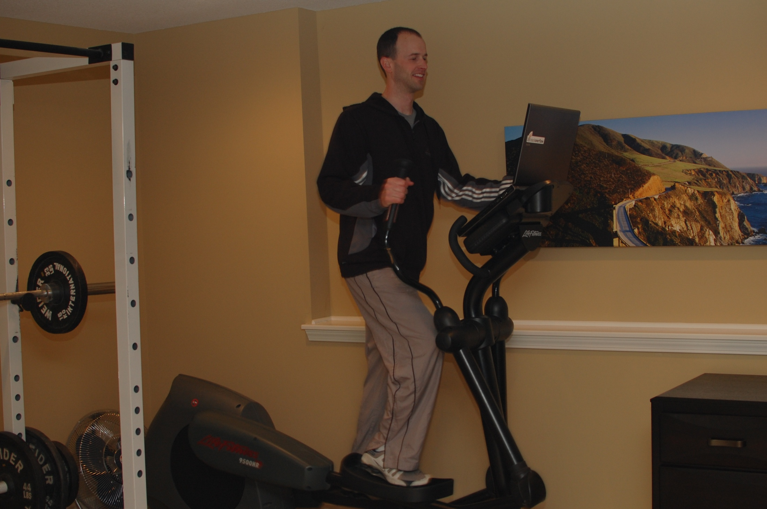
Health, Self Dev, Job
Health, Self Dev, Job

Slide 21
Health, Self Dev, Family

Slide 22
Self Dev, Job, Family

Slide 23
The Maker’s Schedule
Notes:
A single meeting can screw up the whole afternoon.

Slide 24
Most Valuable Resource: Uninterrupted Thought
Notes:
Note book Peopleware
http://adambrault.com/2012/12/04/
FOCUS stands for: Follow One Course Until Successful. - The Midas Touch

Slide 25
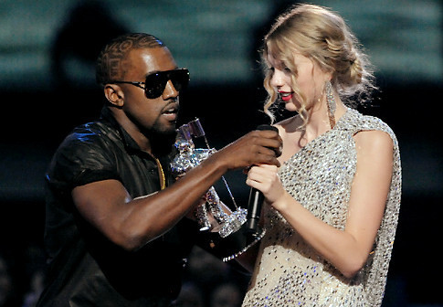
Programmer, Interrupted
Alternate Schedules
Private office
WFH
Larger, less frequent meetings
Calendar snooze

Slide 26
Improve Your Signal to Noise
Your biggest enemies are your bills. The cheaper you can live, the greater your options. Mark Cuban

Slide 27
Clear Your Mind via Cron
Automate relentlessly
Direct deposit paycheck
401k deposits
Bill payments
Weekly, monthly, annual reminders

Slide 28
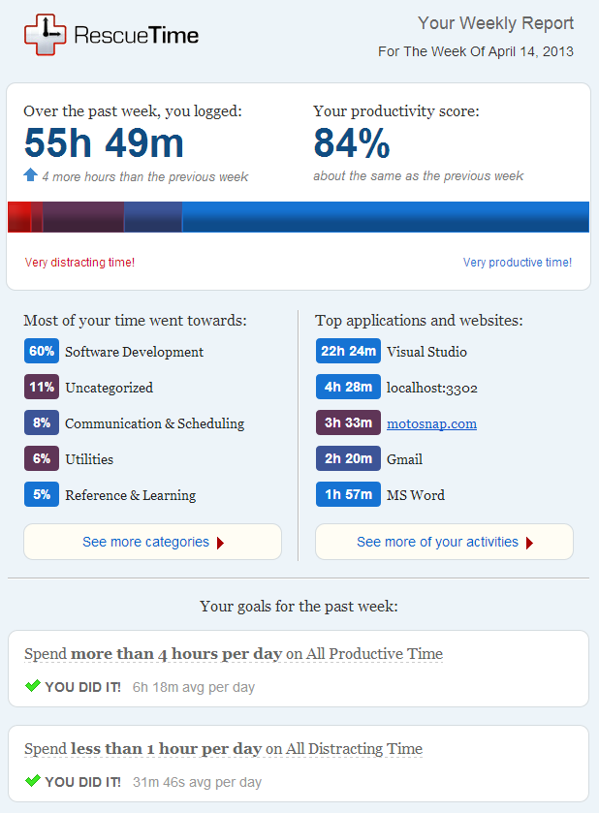

Slide 29
What do you watch on Tuesdays?
Notes:
I don’t have time.
What do you watch on Tuesdays?
Change your default. Select logical defaults.

Slide 30
Outliers Target Media Consumption
Default | Outlier
Yahoo Local Paper USA Today | Hacker News Reddit Programming The Verge
Reality TV Sitcoms Sports | InfoQ videos TekPub or PluralSight DNRTV Ted Talks
Sports Illustrated Car and Driver Whatever is at your dentist | Coding Horror Los Techies Hanselman
Political Opinion Fantasy Science Fiction | Code Complete Seven Languages in Seven Weeks Patterns of Enterprise App Architecture
News
TV
Magazines
Books
Analogous to Agile Manifesto
Notes:
Notice a common thread in the Outlier column? They're activities that make you a better developer. They make you a more valuable team member by giving you both more depth and breadth in the field. Outliers must be deliberate about leveraging free time to assure they're building their skillset that others will line up to leverage.
You can have anything you want in life if you consistently give others what they want.

Slide 31
Manicure Your Stream
Slow media is not for the distracted masses. It's for the focused few.
Notes:
Slow media is not for the distracted masses, it's for the focused few.
Signal vs noise – 37 Signals
RSS - Pocket
InfoQ
Linkedin Groups
Hacker News
Encosia
Scott Guthrie
Scott Hanselman
Coding Horror
Flipboard
Twitter

Slide 32
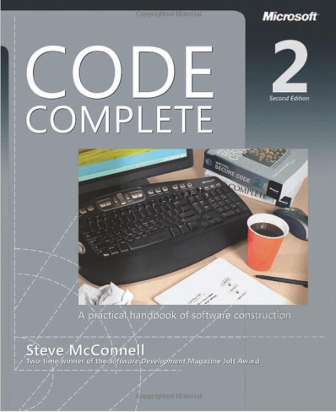
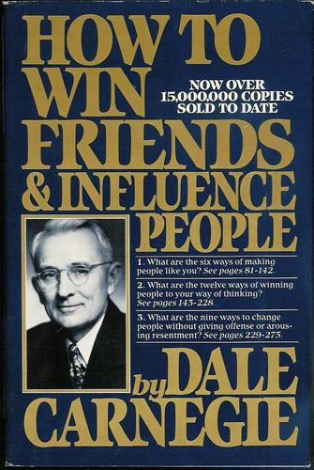
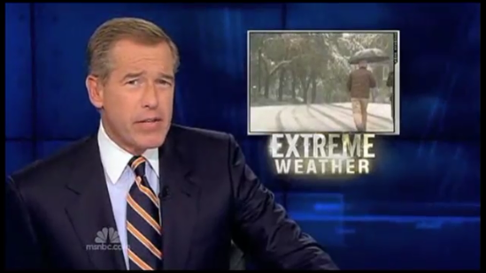
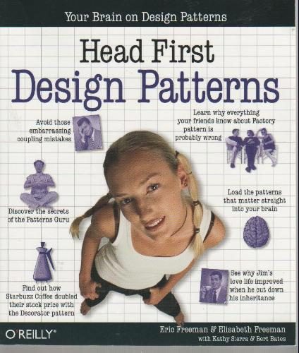
Where’s the Beef?
Changed my life. Opened doors.
Not so much.
The less news you consume,
the bigger the advantage you have.
Rolf Dobelli
Notes:
Wasting time is not a waste. In fact, wasting time is a key part of our lives. Wasting time poorly is a sin, because not only are you forgoing the productivity, generosity and art that comes from work, but you're also giving up the downtime, experimentation and joy that comes from wasting time. If you're going to waste time (and I hope you will) the least you can do is do it well. - Seth Godin

Slide 33
Source: Quora
Example: Bill Gates
Notes:
What will you do about it? Act or let it go. Bill Gates

Slide 34
- Money is Time -
The more you make,
the more time you can buy.
Notes:
Jim collins – turning the flywheel

Slide 35
Outliers Delegate
Notes:
Spend money to save time. Some people are too cheap to save money.
Painting, deck refinishing, auto-detailing, roofing, remodeling, appliance repair, plumbing, auto repair...
Trade money for more time and ultimately more money. Determine what your time is worth. Pay professionals so you have time to either bill or hone your craft. Your most valuable skill is programming, not painting. This trades money today for more money tomorrow. We pay housekeeper, lawn mower, in and out painter, deck refinishing, finished basement. An hour of your time is worth 50 to 100+/hr so

Slide 36
Step 2: Manage Your Image

Slide 37
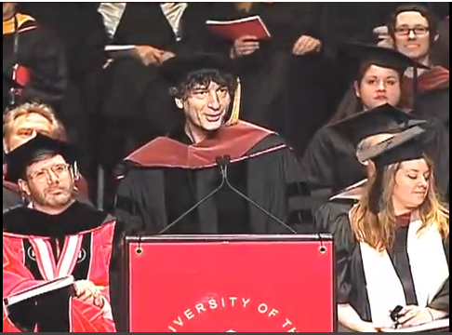
Be easy to work with
Do great work
Deliver on time
Pick
Two
Neil Gaiman
Source: http://www.youtube.com/watch?v=ikAb-NYkseI
Notes:
Risk: Developers tend to focus most on #3. If you’re doing 3 without 1 or 2 your career will falter.
I recommend focusing on 1 and 2 in most orgs. 3 isn’t as important as junior developers think. We should be part of the conversation about what on time means and the implications of missing the schedule.
1= Nice guy
2 = Software Craftsman
3 = Hacker

Slide 38
Be Purpose Built
Neither is a plain daily driver. Neither is cheap either.

Slide 39
Self image == greatest constraint
It's not who we are that keeps us from where we want to be - it's who we THINK we are. Lisa Sayers
Notes:
I am who I think you think I am
It's not who we are that keeps us from where we want to be - it's who we THINK we are. - Lisa Sayers It’s part of why we must leave jobs If you’re offered every job you interview for…
At ftj,. Net contract where I apologized for my thin. Net skills. Only to find I was competitive with their devs.
Vin offerred team lead position. At jha, manager. Lean into uncertainty. If you’re not scared or intimidated you’re not pushing hard enough (Roosevelt quote). Also, conferences can be depressing because I leave convinced others know so much more.

Slide 40
Can I See Your Body of Work?
Notes:
The best indicator of the future success is great work, shipped.

Slide 41
“Do It in Public” – Jeff Atwood
StackOverflow
Github
Hacker News
Reddit Programming
Twitter
Google+

Slide 42
Your Words Are Wasted

Slide 43
Humble Beginnings

Slide 44
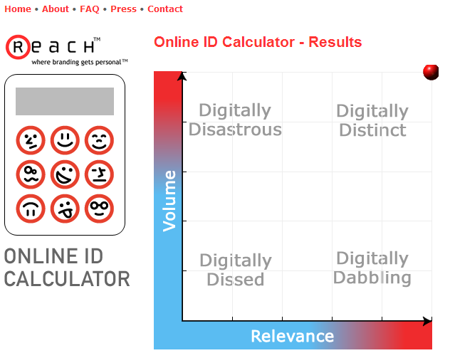
Measure Your Brand
Google Alerts
TweetBeep
Online ID Calculator
www.bit.ly for shared links
Addictomatic
Notes:
http://www.theladders.com/career-advice/5-tools-measure-online-brand?et_id=3218299775&link_id=539&sign=y

Slide 45
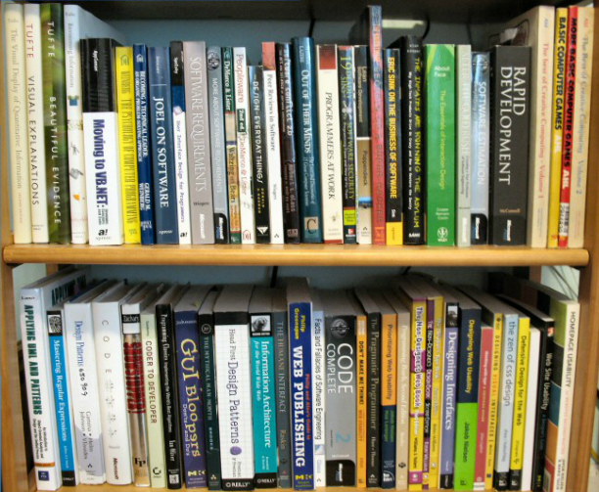
Shelved Credentials
Attract alpha geeks . Convey passion.

Slide 46
Step 3: Own Your Trajectory
Notes:
Story about HP

Slide 47
The Sims
Notes:
Automatic habits!
http://abetterlife.quora.com/How-to-master-your-life
1 good decisions require little thought. To get fit: exercise. To be smarter: read.
2 take good care of yourself
3 build selected skills. to get great at something means saying no to something else. Woody Allen would not be better off if he had spent less time writing and more time at the gym.
There’s no winning The Sims. Everyone dies. There’s no high score. You live your life how you want,

Slide 48
Flash will kill HTML.
Cory House, 1999
Notes:
Story about HP takeover at Sprint

Slide 49
Notes:
Audit your trajectory. working in the right technology? Where do I want to be on the curve? Embrace change. Tech skills you've built today won’t keep you employed. Keep moving. Change directions when market starts shifting.

Slide 50
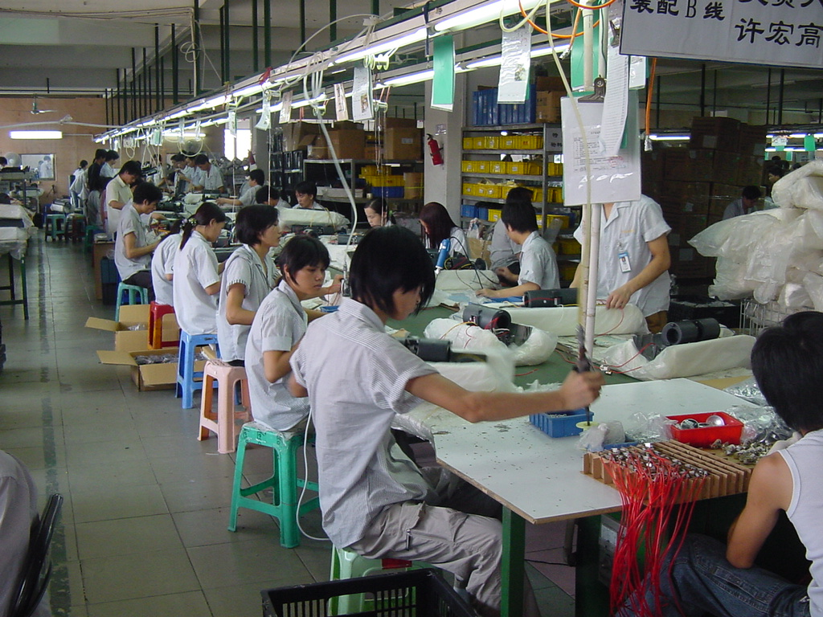
Time = potential knowledge
Risk: Assembly line coder = Create a new x in technology y every z days
Notes:
I create a new x in y every z days.
Do you have 10 years of the same 1 year?
Examples:
I don’t ask num years because i can have a conversation. A # says nothing.
I was hired as lead of php to c# conversion with zero prof exp. But I had put in the time at home.

Slide 52
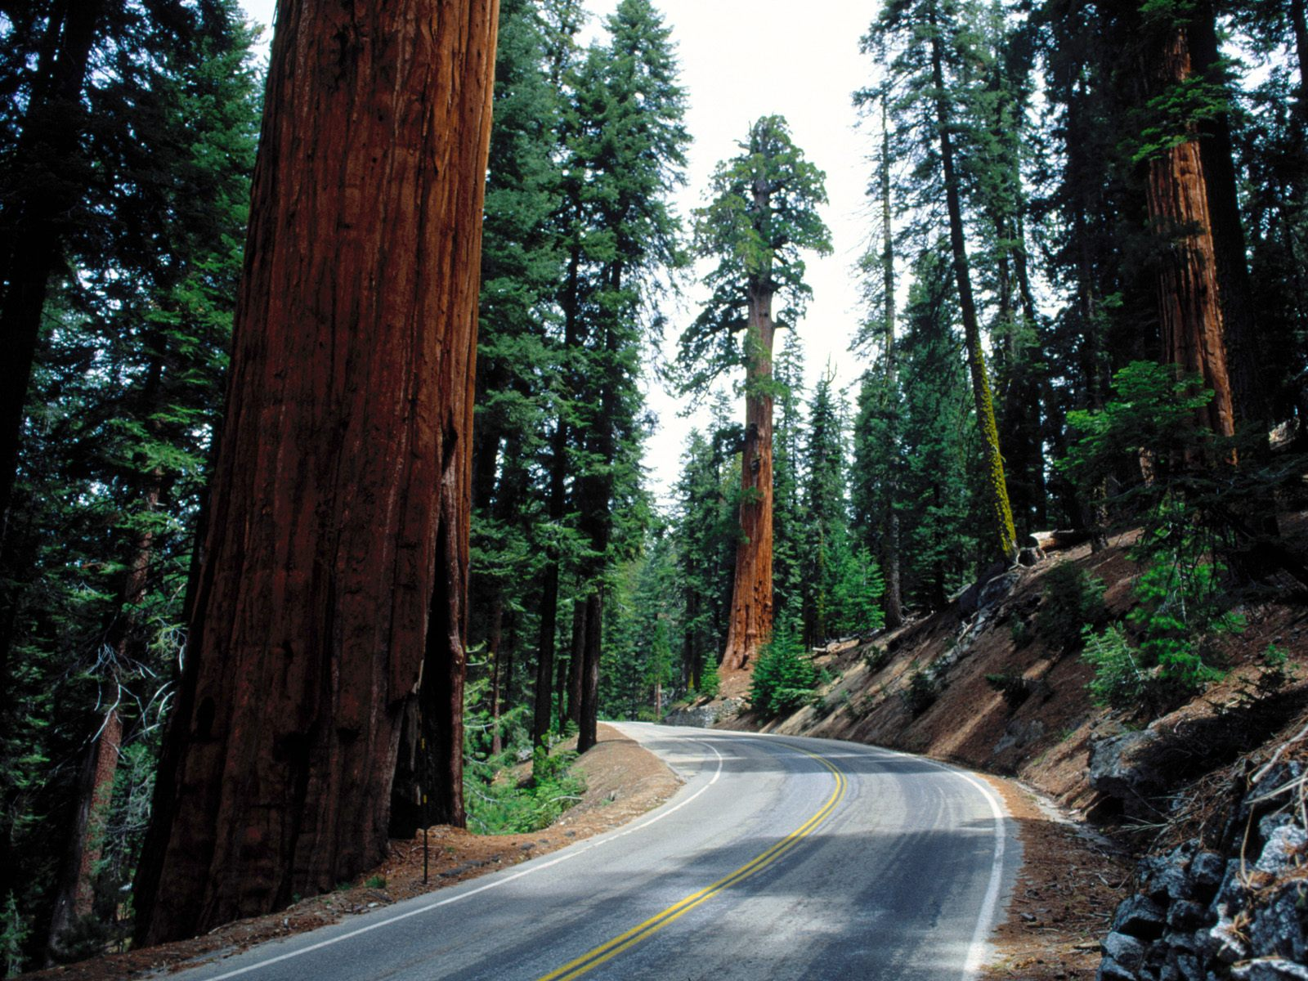
There is no sideways.
Don’t work for money. Work to learn.
Notes:
Foster a growth mindset. Chances are you won't spend a lifetime in your current role. Nor should you feel obligated to do so.
Think about how your current role is preparing you for the next step in your career path. Don't work for money. Work to learn.
If you're doing a job that isn't teaching you something useful for your next gig, then you need to look for ways to stretch in your current role or move on.
Tell children they’re practicing hard and it paid off. Rather than “You must be good at this.”
http://www.linkedin.com/today/post/article/20130409130222-7668018-top-performers-never-work-for-a-company

Slide 53
Key to success: Learn to teach yourself more efficiently than any institution can.
No CERTS
No Training centers
Best cert: Great work, shipped
Notes:
Get ready for irony: This isn’t hard, because we don’t learn much from lectures. And yes, I recognize the irony of me standing up here telling you this.
Everything that constitutes “understanding” science and “thinking scientifically” resides in the long-term memory, which is developed via the construction and assembly of component proteins. So a person who does not go through this extended mental construction process simply cannot achieve mastery of a subject.
you can’t really know anything if you just remember isolated facts and try and bang ‘em back. If the facts don’t hang together on a latticework of theory, you don’t have them in a usable form.
http://www.farnamstreetblog.com/2013/01/how-people-learn
I learned c++ cobol pascal cics vb in college. My process: Read, research, write, repeat.
learn techniques to force your hand. play mind tricks on yourself. Confs force you to get better and organize your stimulus fraction (thoughts)

Slide 54
What if every day moved you closer to independence and automated income?
Notes:
What if every work task in your day were getting you closer to automated daily income? With traditional employment, at the end of the day, you're no closer to being off the treadmill. You're handed a days pay for a days work. Only automated pay leads to freedom through scale.
Write once, sell many. Whether a physical or a knowledge product. But you can only sell an hour of your life once. It does not scale.

Slide 55
Search for Scale
L1
Work
L2
Lead (Talk about work)
L3
Own
Bill by the hour
Do as you're told
Mentor, hire & lead teams
Products: SAAS, PAAS
Fix bugs
Select architectures & technologies
Define project scope & processes
Frameworks
Author
We pay people who are brave enough to lead
Notes:
We pay people who are brave enough to lead us without a clear path far more. Ambiguity pays. Leadership pays. Risk pays. Just like the market.

Slide 56
Summary
Command Your Time
Manage Your Image
Own Your Trajectory

Slide 57
My Challeges to You

Slide 58
Your Luck Surface Area is directly proportional to the degree to which you do something you're passionate about combined with the total number of people to whom this is effectively communicated. Jason Roberts
Notes:
Speaking
Making the Hang
User Groups
Startup Weekends
Conferences
Independent consulting
Blogging
Tweeting
Shipping

Slide 59
Speak Startup Weekend Attend Conference / User Group Code for Charity Consult Blog Tweet Ship Never Eat Alone Make the Hang
Steal my stuff
Notes:
Why aren't you speaking at this conference? No seriously.
Genuine flattery gets you everywhere
Buy lunch
Everyone has a desire to feel important

Slide 60
Lean Into Uncertainty
Find what scares you and run at it.
Taking a lead job
Managing others
Speaking
Committing to open source
Shipping art

Slide 61
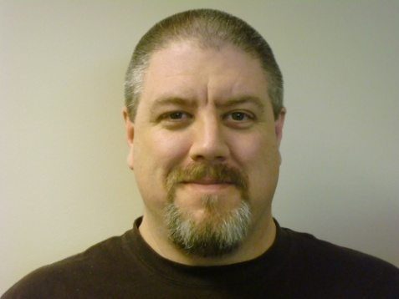
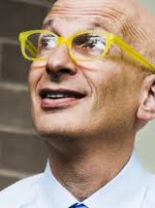
Choose Yourself
Easy | Hard | Hardest
Attend | Speak | Create
Lurk | Post | Build
Read | Write | Tribe
Learn | Master | Write
Conference
Forum
Blog
Framework
Notes:
Note that none of these people had permission.
Choose Hard. Coding is harder than reading. Reading is harder than watching TV. Many activities offer both growth potential and publicity. All these activities set you apart, but the effect is magnified as you move right.

Slide 62
You are the average of the five people you spend the most time with. Jim Rohn

Slide 63
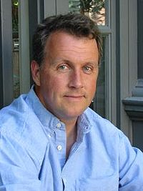
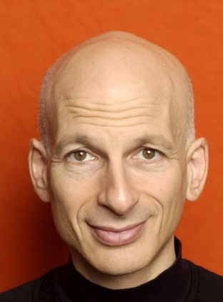
You Don’t Need Permission
Notes:
Note: All these people are flawed. Diversity helps.

Slide 64
Pick a niche
Consistently do things that people want.
Notes:
My niche: I teach software development, speak, and build rich web applications

Slide 65
Someone graduating from college thinks, and is told, that he needs to get a job, as if the important thing were becoming a member of an institution. You need to start doing something people want. You don't need to join a company to do that. Paul Graham
Notes:
A job means doing something people want, averaged together with everyone else in that company.
If you want to go faster, it's a problem to have your work tangled together with a large number of other people's. In a large group, your performance is not separately measurable-- and the rest of the group slows you down. – Paul Graham

Slide 66
If it’s work…we try to do less.
If it’s art…we try to do more. Seth Godin
Cory House | @housecor | bitnative.com

Slide 67
Sources
Cory House | @housecor | bitnative.com
The Passionate Programmer: Creating a Remarkable Career in Software Development - Chad Fowler
Outliers: The Story of Success - Malcolm Gladwell
The Happiness Advantage - Shawn Achor
How to Stop Sucking and Be Awesome Instead - Jeff Atwood
Drive: The Surprising Truth About What Motivates Us - Daniel Pink
Switch: How to Change Things When Change Is Hard - Chip Heath & Dan Heath
Never Eat Alone: And Other Secrets to Success, One Relationship at a Time - Keith Ferrazzi
The Power of Habit – Charles Duhigg
How to Make Wealth - Paul Graham
Your Words Are Wasted - Scott Hanselman
Uncertainty: Turning Fear and Doubt into Fuel for Brilliance - Jonathan Fields
Poke the Box - Seth Godin
How to Win Friends and Influence People - Dale Carnegie
Delivering Happiness – A path to profits, passion and purpose - Tony Hsieh
Peopleware: Productive Projects and Teams - Tom DeMarco & Timothy Lister
The power of ignoring mainstream news – Joel Gascione

